Slide 1
Overview of Brewster Coastal Advisory Group (BCAG) and the Brewster Coastal Adaptation Strategy
Presentation to the Brewster Board of Selectmen by Horsley Witten Group and the Consensus Building Institute May 22, 2017
Notes:
Opening slide.

Slide 2
Project Task
Develop a Coastal Adaptation Strategy for Brewster to guide future decisions regarding access and management of coastal areas in light of future coastal change, sea level rise (SLR), and erosion.

Slide 3
Purpose of the BCAG
Engage residents and stakeholders in a public process – incorporating vulnerability and risk information with public needs, concerns, and values – and develop and publicly present a set of strategies and mechanisms to address key community vulnerabilities, issues, and priorities and to identify the community’s preferred adaptation strategies.

Slide 4
BCAG Development
Interviews with 45 individuals (Fall 2015)
Draft and refined BCAG process recommendations (December 2015)
Applications of Interest for BCAG Membership, representing a range of perspectives, demographics, and points of view within the community (Dec-Jan)
Selection of BCAG members, including all members of the Town’s established Coastal Committee, and Liaisons from related Town bodies (January 2016)

Slide 5
BCAG Process
Held 8 3-hr meetings and a 2-hr public visioning session, (mostly) televised and open to the public (Feb – Sept 2016)
Examined coastal conditions & threats and community needs.
Identified, refined, and reached consensus on a set of guiding principles
Explored potential strategies for applying these at both the town-wide and landing-by-landing levels.
Reached consensus on many town-wide approaches for coastal adaptation and a set of recommendations to guide next steps and implementation
Collected a set of additional suggestions – including ideas for landing-specific approaches – developed in assigned smaller working groups or as individuals.

Slide 6
BCAG Data and Inputs
Technical and Scientific Analysis: Technical experts presented data on coastal threats faced by the Town, identified specific challenges and issues town-wide and landing-by-landing, and helped frame potential interventions and actions to be considered
the Horsley Witten Group, Inc.
the Center for Coastal Studies
LEC Environmental
Town Survey: Town online coastal access survey on the use of public coastal beaches in the ‘summer’ season.

Slide 7
Consensus Vision
The Town of Brewster will preserve and protect the community’s coastal resources and expand access to its public beaches through public consensus, and in ways that preserve the natural habitat and peaceful character of the coastal environment and coastal neighborhoods, respect the overall coastal and land-based ecosystem, and adapt to long-term projections for coastal change.

Slide 8
Guiding Principles (in alpha order)
Access:
Maintain and expand the opportunities for all to access Brewster’s public beaches year-round.
Meet peak season access needs by exploring opportunities at all public access points, and through alternative means, including off-site parking, improved biking and pedestrian access, and investigation of shuttle options.
Consider those with limited mobility and users of wheelchairs, families, commercial and recreational shell-fishermen, and emergency access, and the safety needs of providing and balancing this access for all.
Notes:
All decisions made about the future of Brewster’s public coastal areas should uphold the following community values, priorities, and desires (listed in no particular order):

Slide 9
Guiding Principles (in alpha order)
Adaptive: Recognize that the changing nature of coastal resources requires flexibility and adaptive planning, with ongoing monitoring of changing conditions and community needs, to best respond to new technologies, opportunities, and scientific uncertainties.
Consensus-based: Provide for public input and build community consensus through all phases of the planning and implementation of the Coastal Adaptation Strategy.
Notes:
All decisions made about the future of Brewster’s public coastal areas should uphold the following community values, priorities, and desires (listed in no particular order):

Slide 10
Guiding Principles (in alpha order)
Holistic: Protect the whole coastal system, including beaches and dunes, wildlife habitat, salt marshes, and other ecosystem services. Seek actions appropriate to coastal projections and community needs that build on and enhance the coast as well as the ecosystem as a whole.
Natural Beauty: Protect and maintain the natural beauty, non-commercial, peaceful, quiet, spacious, and “small feel” of Brewster’s coast, beaches, and coastal neighborhoods, and safeguard their long-term significance for town residents and visitors.
Notes:
All decisions made about the future of Brewster’s public coastal areas should uphold the following community values, priorities, and desires (listed in no particular order):

Slide 11
Guiding Principles (in alpha order)
Science-based, innovative, and realistic: Seek long-term solutions based on the best available science that are innovative, realistic, and achievable; that work along with nature and build climate resiliency today and into the future; and that are both environmentally and fiscally sustainable.
Notes:
All decisions made about the future of Brewster’s public coastal areas should uphold the following community values, priorities, and desires (listed in no particular order):

Slide 12
Planning Scenarios

Slide 13
Tides in Brewster – Some context
Tidal range (consecutive Low/High Tides):
Average: 10.3 feet
Ranging from 6.8 to 15.2 feet
Relative to the shoreline (Mean High Water or MHW)
Most (58%) high tides are above MHW
~ 1 in 17 high tides (5.8%) are ≥ 2 ft above MHW: that’s 41 high tides
3 greatest high tides are 2.8 feet above MHW
Source: 2016 NOAA tidal predictions. Sesuit Harbor, East Dennis, MA
Notes:
Mean High Water (MHW) is the average of all the high water heights observed over a period of several years. For example, in the USA this period spans 19 years and is referred to as the National Tidal Datum Epoch. This also represents the shoreline on nautical charts.
“The shoreline shown on nautical charts represents the line of contact between the land and water at a selected vertical datum. In areas affected by tidal fluctuations, this is usually the mean high-water line.” (http://www.nauticalcharts.noaa.gov/mcd/learnnc_shoreline.html)

Slide 14
Measured Historic Storm Surges NOAA Boston Gauge
Surge (feet) | Storm Date | Storm Name
4.21' | February 9, 2013 | Winter Storm Nemo
4.57' | October 29, 2012 | Hurricane Sandy
4.88' | October 30, 1991 | "Perfect Storm" Halloween Nor'easter
4.34' | February 6, 1978 | Blizzard of 1978
3.69' | February 14, 1940 | Valentine's Day Nor'easter
For visualizations purposes, assume 4 ft surge
Notes:
A storm surge = an abnormal rise of water generated by a storm, over and above the predicted astronomical tides.
They matter because:
They can happen today, tomorrow, next year
They are cumulative (additive), over:
High tides
SLR
Coastal change processes

Slide 15
Coastal Flooding Scenarios
MHW: today’s benchmark for coastal flooding
MHW + 2 ft: a particularly high tide in 2016, or a more average tide with a storm surge or some SLR
MHW + 4 ft: an average tide with 4 ft of SLR, or 2 ft of SLR with a 2-ft storm surge
MHW + 8 ft: an average tide with a combination of 4 ft of SLR, and 4 ft of storm surge
Notes:
Storm surge: 4 ft (a “Nor-Easter”)
To put things into perspective
2 ft above MHW already occurs 40 times a year
4 ft SLR is a daily equivalent to a Nor-Easter surge

Slide 16
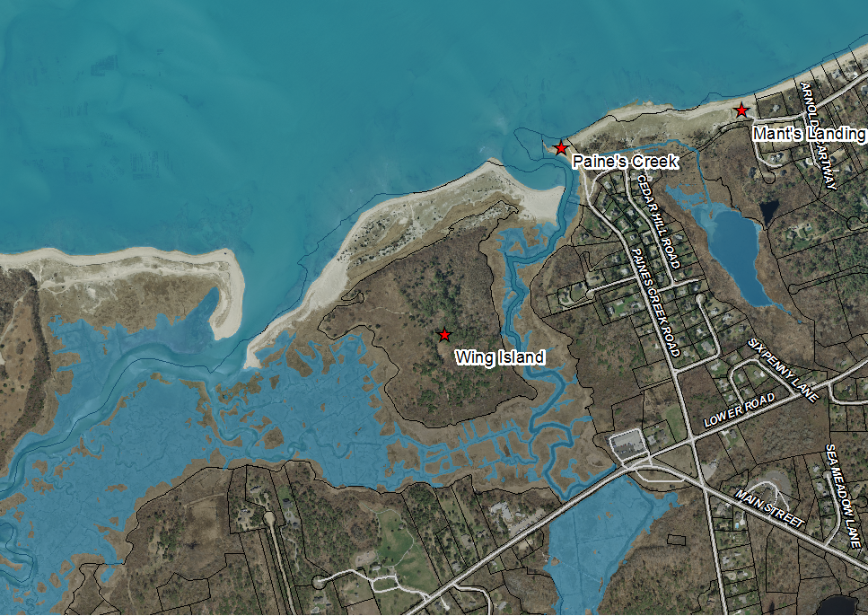
Paine’s Creek, Mant’s Landing, and Wing Island
Mean High Water

Slide 17
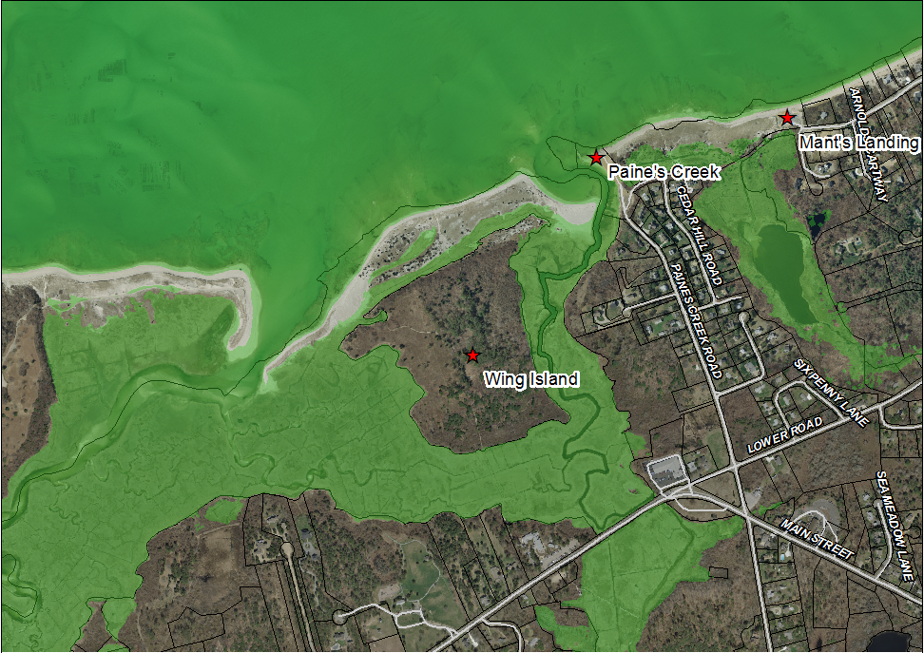
Paine’s Creek, Mant’s Landing, and Wing Island
MHW + 2 feet

Slide 18
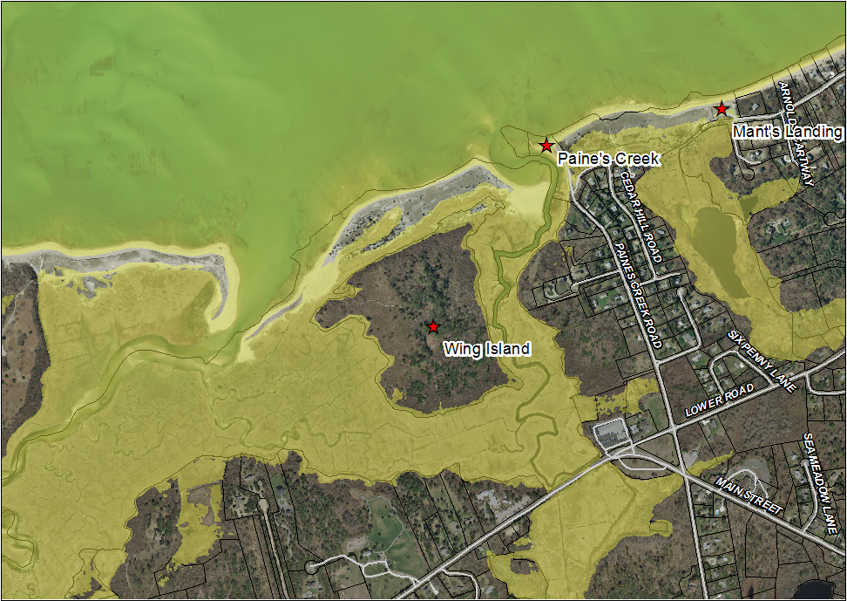
Paine’s Creek, Mant’s Landing, and Wing Island
MHW + 4 feet

Slide 19
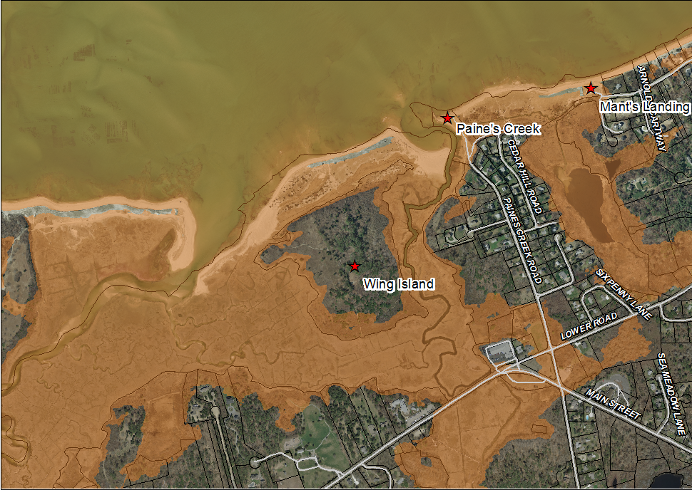
Paine’s Creek, Mant’s Landing, and Wing Island
MHW + 8 feet

Slide 20
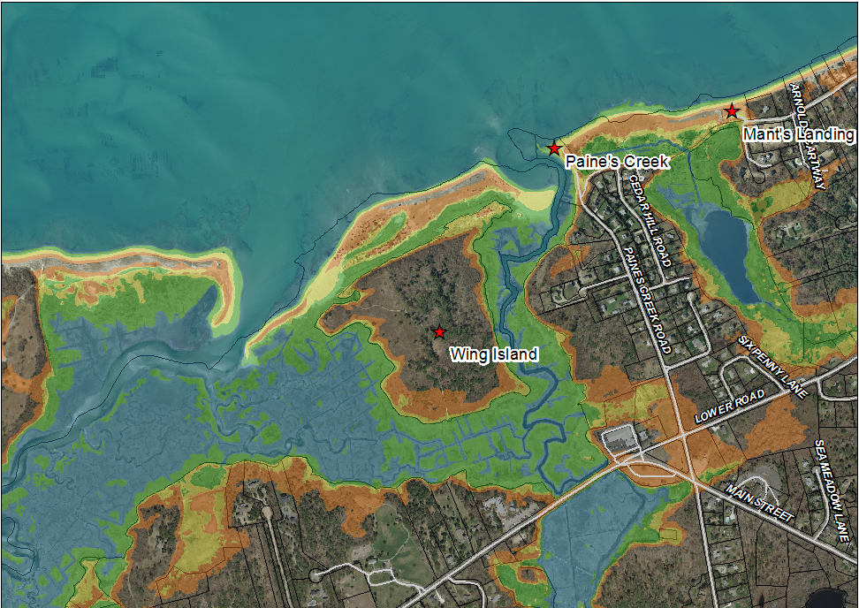
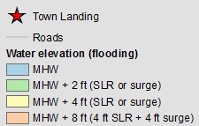
Paine’s Creek, Mant’s Landing, and Wing Island
All Flooding Scenarios

Slide 21
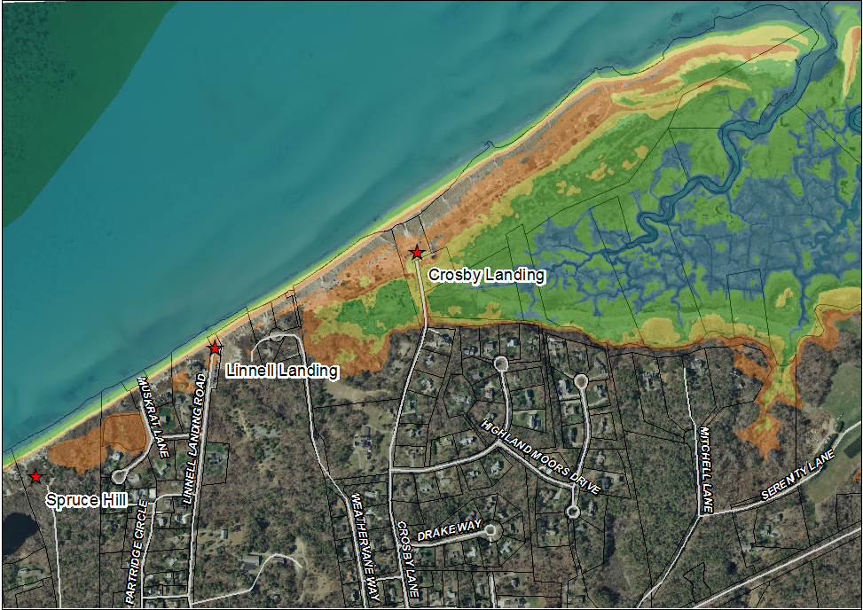
Spruce Hill, Linnell and Crosby Landings
All Flooding Scenarios

Slide 22
Vulnerabilities and Impacts

Slide 23
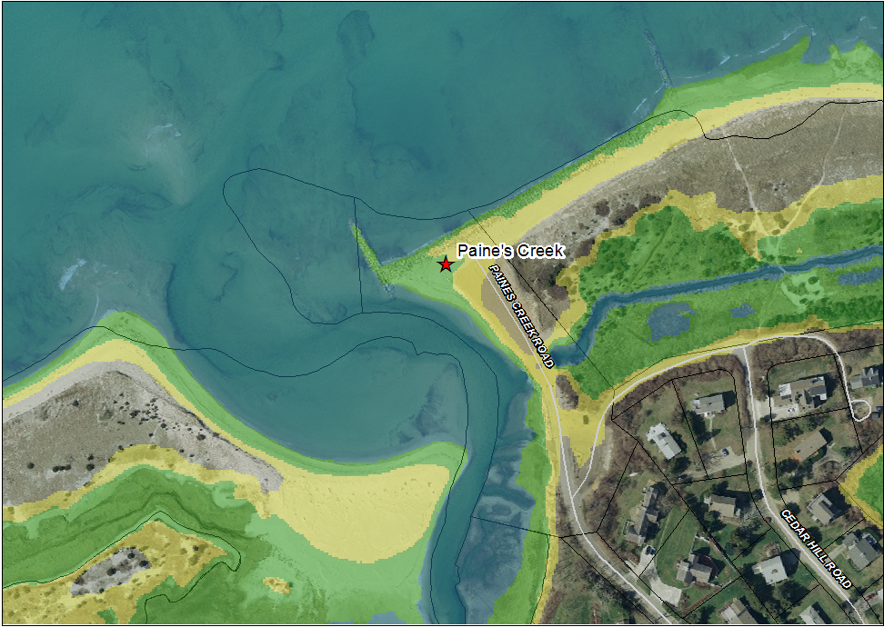
Paine’s Creek – Access Impacts

Slide 24
Preliminary Impacts to Parking and Access
Coastal Landing | Parking Spaces | Scenarios with Impacts
 |  | Parking | Access to Parking
Paines Creek | 19 | 4 ft | 8 ft
Mants | 44 | 4 ft | 4 ft
Saints | 38 | - | -
Breakwater | 6 | - | 4 ft
Breakwater Beach | 62 | 8 ft | 8 ft
Point of Rocks | 3+8 | - | -
Ellis | 19 | 8 ft | -
Linnell | 25 | 8 ft | -
Crosby | 60 | 4 ft | 4 ft
Note: 4 ft corresponds to either a 4ft storm surge, or 4 ft of SLR
8 ft correspond to 4 ft of SLR + 4 ft of storm surge

Slide 25
Consensus Adaptation Strategy Recommendations

Slide 26
Evaluate, expand, and explore alternative access to town landings (via public and public-private means)
Bicycles and Pedestrians
Shuttle
Satellite Parking
Seek and evaluate new access locations
Maintain access for emergency vehicles and shellfishing
Broaden and improve access (including visual) for individuals with limited mobility

Slide 27
Continue beach management and restoration efforts, with periodic review
Promote and support wetland resource adaptation (Crosby Lane Culvert/Salt Marsh Restoration)
Continue analysis of climate impacts
Implement ongoing adaptive management
Prioritize future projects on underutilized beaches to avoid overcrowding

Slide 28
Consensus Implementation Strategy Recommendations

Slide 29
Update Coastal Committee charge to:
Develop a Brewster Coastal Resource Management Plan (BCRMP), drawing on this Strategy and evaluating actions based on the guiding principles
Integrate robust public participation in all phases of its work and in the development of the Management Plan
Coordinate planning and implementation across institutional silos, involving appropriate town bodies, to incorporate climate change and adaptation strategies into policies, plans, and regulations
Monitor changing coastal conditions and evolving community needs
Monitor and evaluate implemented adaptation strategies.

Slide 30
After completing the Brewster Coastal Resource Management Plan (BCRMP):
The Town should have the proper institutional structure to ensure that it is implemented.
The BoS or the Town Administrator should form a task force to review the parameters of the existing Coastal Committee to ensure sufficient staff, capacity, authority, and membership from other relevant town boards and community representation.
The body in charge of implementation of the BCRMP should have sufficient staffing and financial resources, as well as the appropriate authority, scope, and membership.

Slide 31
When developing significant coastal projects:
The Town should engage in a pre-regulatory and pre-decisional public process as early as possible in the development of the project.
Best practices for public engagement include:
engaging members of the public and interested stakeholders in constructive and exploratory discussion of project goals
exploration of a range of potential strategies
evaluation of options using the guiding principles; and
collaboration to seek an approach that balances across the priorities and trade-offs

Slide 32
Additional Recommendations
Advisory Group participants offered additional suggestions for ways to shape and improve the Strategy.
However, the group ran out of time to examine and discuss many of the promising ideas that were suggested.
BCAG members agreed that these ideas should nonetheless be included in the report, so that the Coastal Committee and other town processes can explore them further in any future plans evolving from this document.
A detailed break-down of these ideas can be found in the report.

Slide 33
Questions?

